Slide 1
Energy 2020
Presented by Kelsey Nunez
And the Idaho Energy Collaborative
Idaho Green Expo Vision 2020
May 8-9th, 2010
Notes:
The beginning

Slide 2
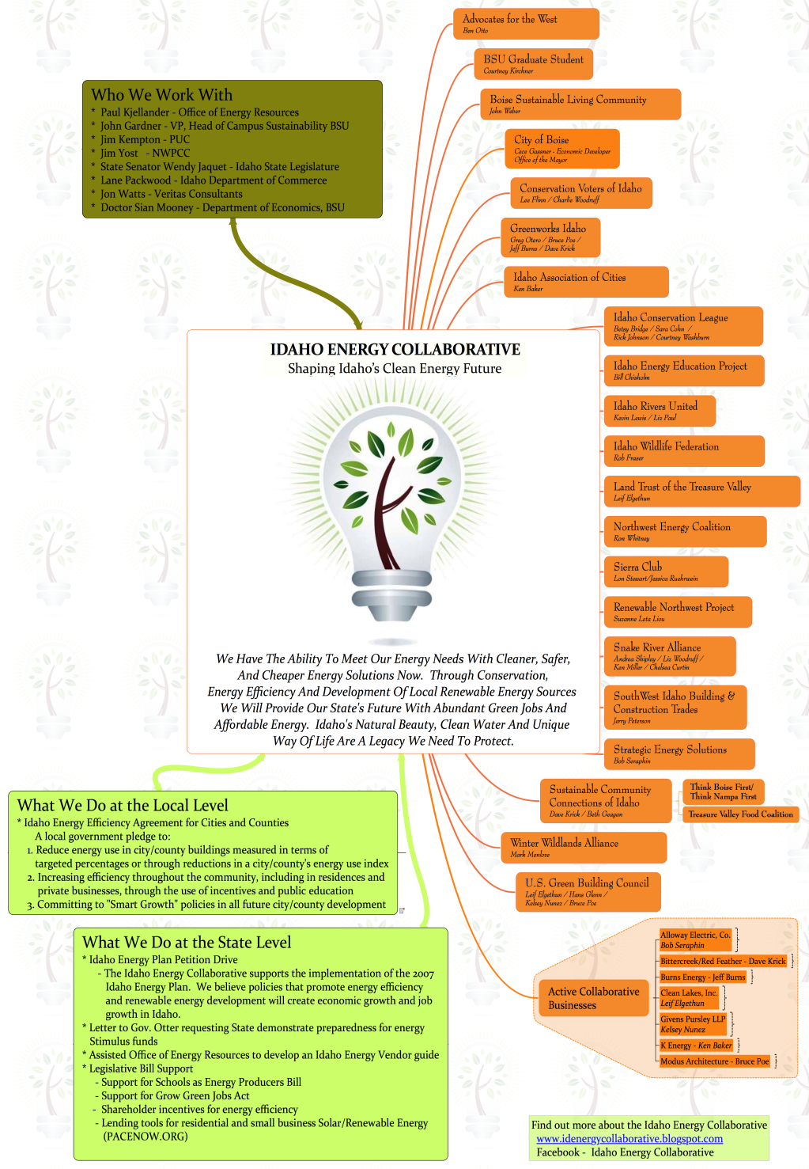
Over 30 Separate Orgs./Businesses
Local/State Clean Energy Advocacy
Action Oriented Collaboration

Slide 3
Presentation Timeline
11
12
13
14
16
17
18
19
Present Day
2015
2020

Slide 4
So, what are the sources of
Idaho’s energy for electricity?
Or, how do we
power our homes & businesses in Idaho?
Coal
47%
Nuclear
1%
Traditional Hydro
46%
Natural Gas
3%
Wind
2%
Other Renewable
<1%
How do federal subsidies add up
for our country’s energy mix?
Notes:
Looking at our daily lives in Idaho in 2010, where does our non-transportation related energy come from? In other words, where does the energy for our electricity come from?

Slide 5
Same house adjusted for
2002-2008 federal subsidies.
$71 Billion
Oil and Coal
55%
$48 Billion
Nuclear
33%
$12 Billion
All others
(including hydro, wind,
and renewable tech)
8%
Data from study conducted by the
Environmental Law Institute
Notes:
From the 1950’s until 2010 we provided hundreds of billions in subsidy to Oil/Coal/Nuclear & Gas while ignoring opportunities to invest in Energy Efficiency, Conservation and Clean Renewables
A major study by the Environmental Law Group details how this broke out between 2002 and 2008… even as we talked about expanding renewable energy opportunities, substantially larger subsidies were given to fossil fuels and Nuclear than to renewables.
These subsides, given to mature fossil fuel energy sources, represented a direct cost to taxpayers and were clearly influencing the sources of our energy in Idaho.

Slide 6
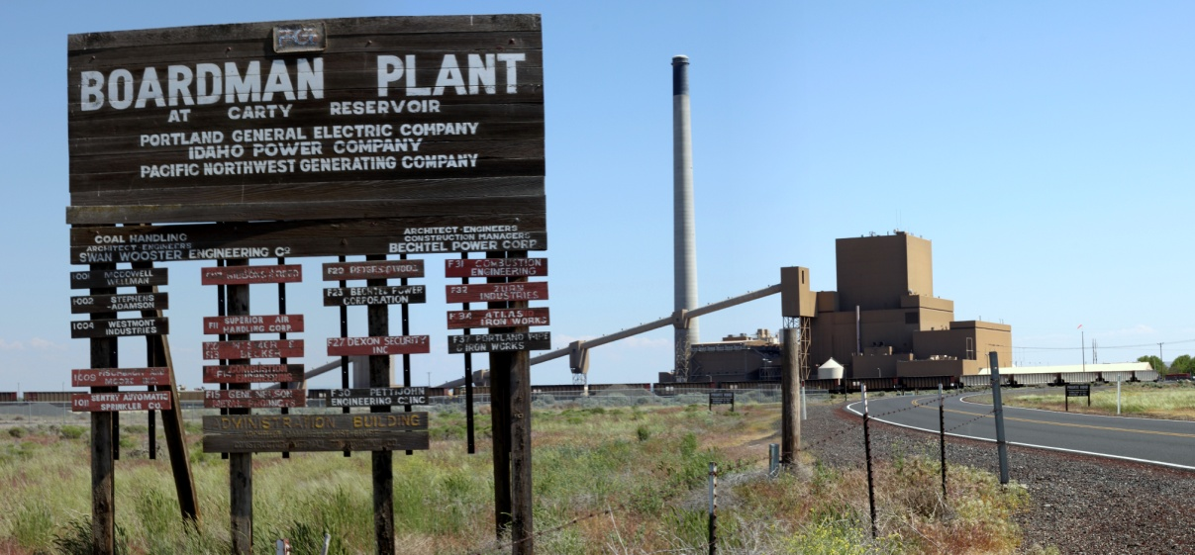
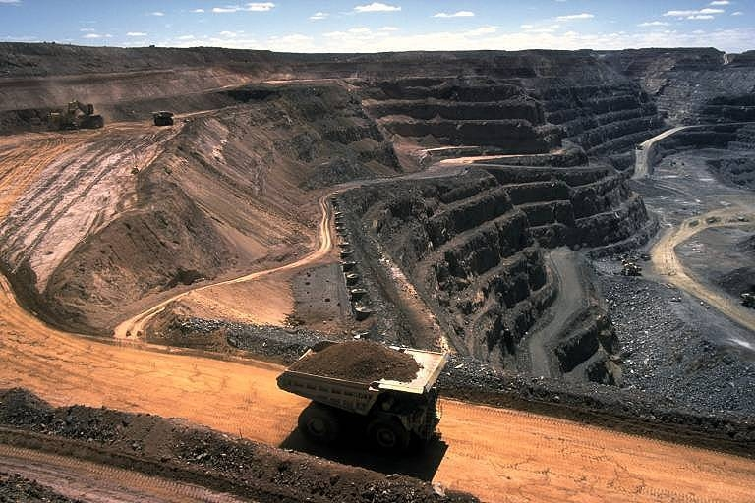
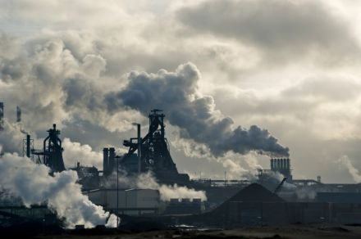
In 2010, almost half of Idaho’s energy…
…came from coal
Notes:
Idaho purchased billions in energy in the past, mostly cheap coal that was imported from neighboring States… many in our State believed our energy came mostly from Hydro and that was not the case.

Slide 7
Expanding clean, renewable energy options.
Geothermal
~1%
=
Solar PV/Solar Thermal
Biomass
Micro-hydro
Present day energy mix
Notes:
Idaho’s abundant resource of Geothermal and Solar represented less than 1% of our energy supply in 2010.

Slide 8
Presentation Timeline
11
12
13
14
16
17
18
19
Present Day
2015
2020
So, what happened in the 10 years
Between 2010 and 2020?
Notes:
Moving into our future, we arrive at 2020…

Slide 9
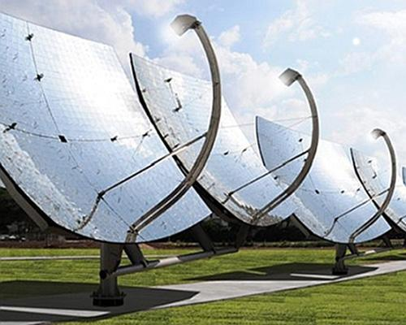
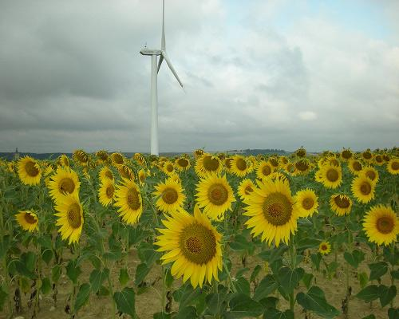
Idaho decided to lead the nation
60% Clean Renewable Energy by 2020
100% Clean Renewable Energy by 2030
How?

Slide 10
Energy Mix in 2020
Biomass
<1%
Coal
18%
Traditional Hydro
30%
Micro-Hydro
6%
Natural Gas
20%
Wind
13%
Geothermal
6%
Solar
6%
Nuclear
< 1%
Notes:
Through the determined leadership of our State Legislature and the bold Renewable Energy Portfolio Standard they put in place in 2012 , and advancements in battery storage and baseload generation technology, we achieved the goal of a 60% Clean Renewable Energy mix in Idaho

Slide 11
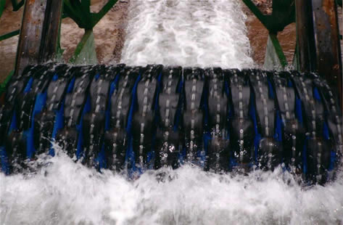
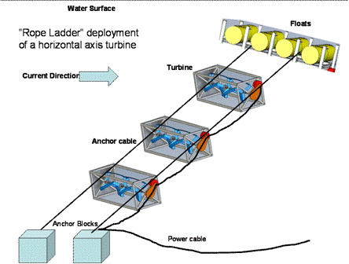
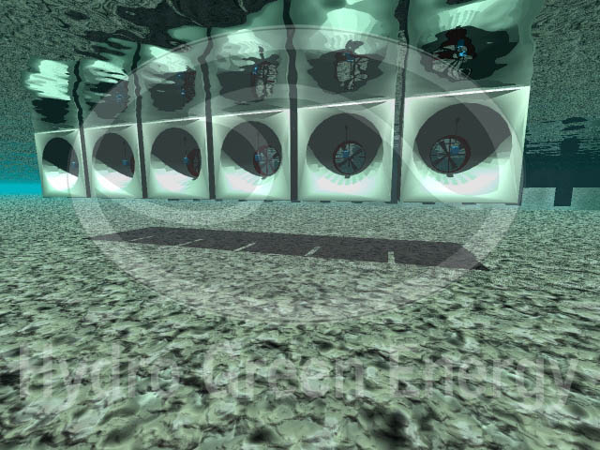
Micro-Hydro – Blue Energy
Energy Mix in 2020
Notes:
Creating distributed power out of our rivers, streams and irrigation canals. Huge potential and support Ag. Community!

Slide 12
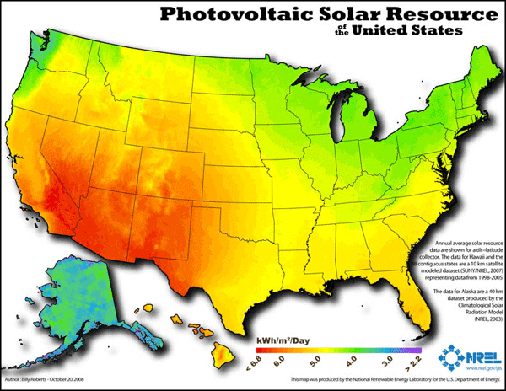
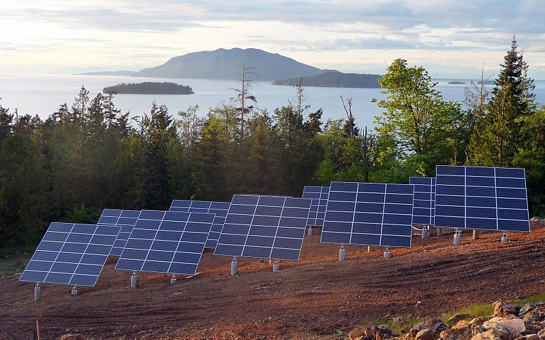
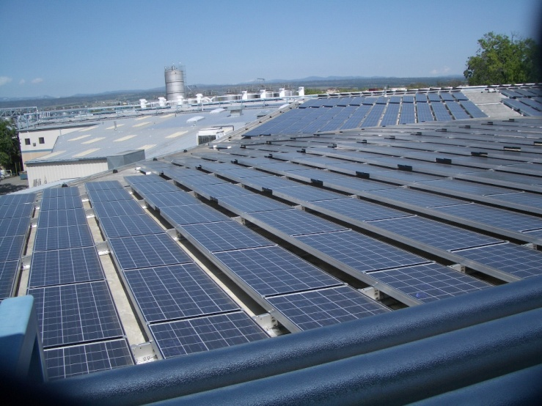
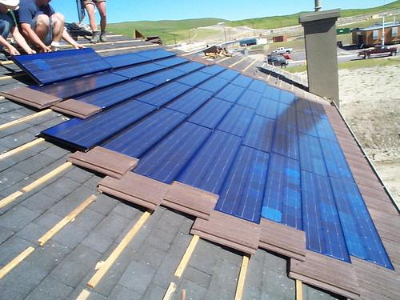
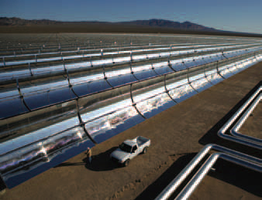
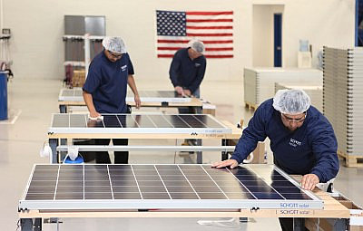
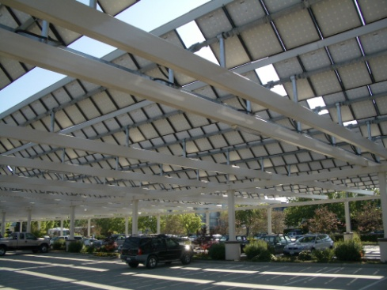
Energy Mix in 2020
300 Days of Sunshine a year has made Southern Idaho a Solar Leader
30,000 Solar Rooftops, two 100MW Solar Thermal Facilities, neighborhood size generators
20,000 Idaho Citizens work in Solar Energy Related Fields

Slide 13
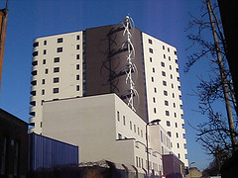
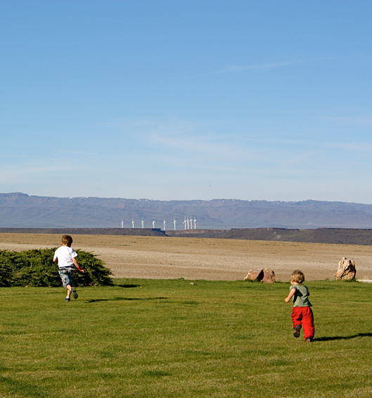
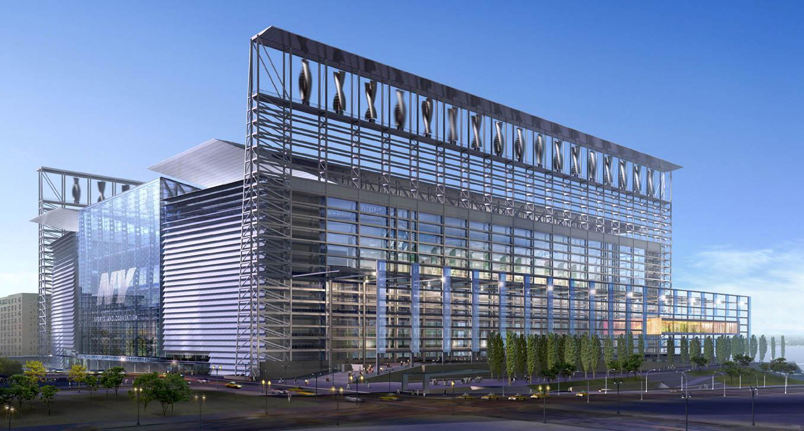
Energy Mix in 2020
Idaho utilizes wind power as the
13th windiest state in the U.S.A.

Slide 14
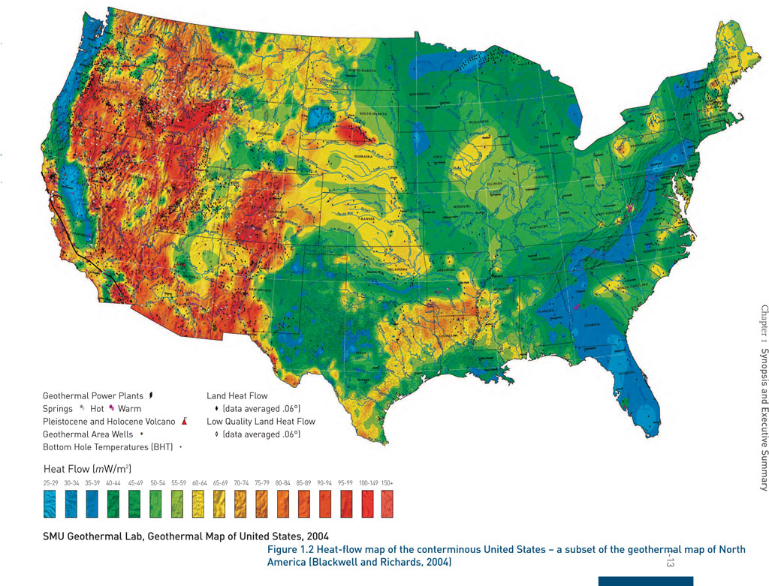
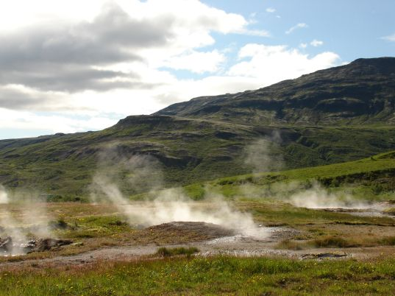
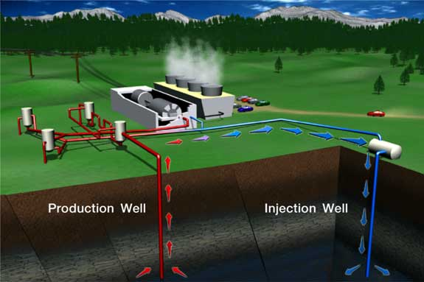
Energy Mix in 2020
Idaho is prime for geothermal innovation
We became a hot bed of geothermal leadership,
driving geothermal research for the nation.
Notes:
So, as excited as we are about the energy technology of Idaho’s future, this conversation isn’t only about generating energy, it’s about conserving energy, too. (Slide switch)

